Slide 1


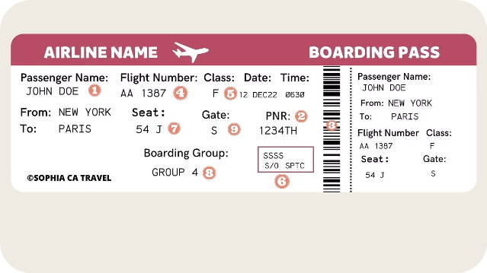
Reconstruct Itinerary
Reconstructing an itinerary is an algorithmic problem that involves finding the correct order of flights to complete a journey given a set of flight data.

Slide 2

Overview of the Problem
Imagine you're given a list of flights, each with a departure and arrival city. Your task is to reconstruct the optimal itinerary by determining the correct order of these flights to visit all cities exactly once, starting and ending at a specific city.
1
Input
2
Output
A list of flights, each represented by a departure city and arrival city.
The reconstructed itinerary, a list of cities visited in the correct order.
3
Constraints
4
Complexity
The itinerary must start and end at a specific city, and each city must be visited exactly once.
The challenge lies in finding an efficient algorithm to reconstruct the itinerary while satisfying the constraints.

Slide 3

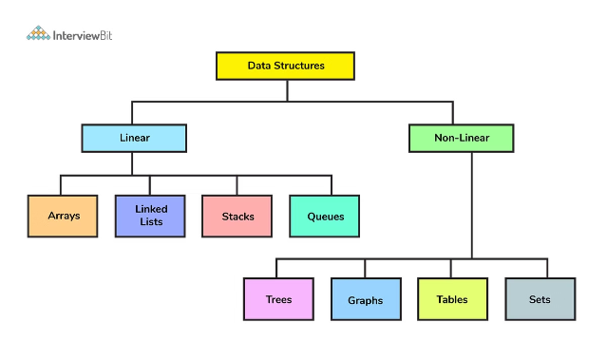
Input Data Structure
The input data for this problem can be represented using a graph data structure. Each city is a node, and each flight is an edge connecting two nodes.
Data Structure
Description
Graph
Represents the flights and cities. Nodes are cities, and edges are flights.
Edge
Represents a flight, with departure and arrival city information.

Slide 4





Approach to the Problem
The most common approach to solving this problem is using a Depth-First Search (DFS) algorithm. The idea is to traverse the graph starting from the departure city, exploring all possible paths until we find a path that visits all cities exactly once and ends at the destination city.
Start at Departure City
Begin the traversal from the specified departure city.
Explore Flight Connections
For each city, explore all available flights (edges) connecting to other cities.
Backtrack and Continue
If a path leads to a dead end (no further flights) or a city is visited twice, backtrack to the previous city and explore other flight options.

Slide 5
Algorithm Implementation
The algorithm uses recursion to traverse the graph. It keeps track of visited cities and the current path being explored. The algorithm backtracks when it reaches a dead end or a city is visited twice.
Initialization
Depth-First Search (DFS)
Reconstruct Itinerary
Initialize the graph data structure, the starting city, and an empty list to store the reconstructed itinerary.
Implement a recursive DFS function that takes the current city, visited cities, and the current path as input. The function explores all possible flights from the current city, and if a valid itinerary is found, it returns it.
Call the DFS function with the starting city, an empty set of visited cities, and an empty path. The algorithm returns the reconstructed itinerary if it exists, otherwise, it returns an empty list.

Slide 6
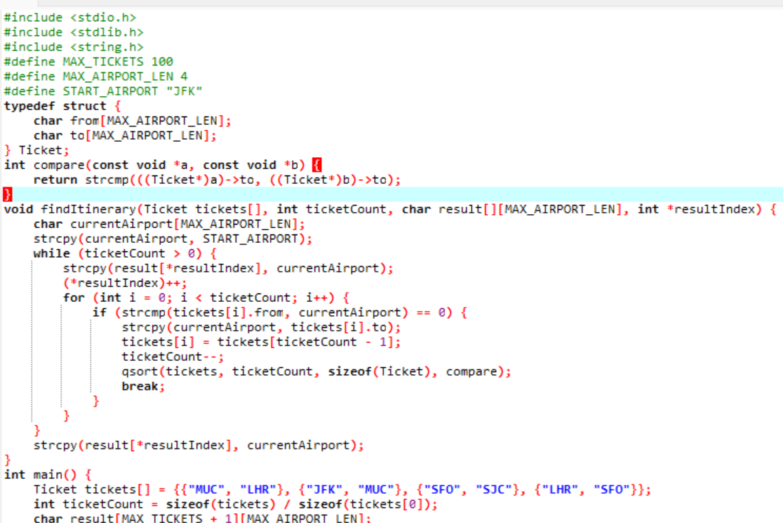
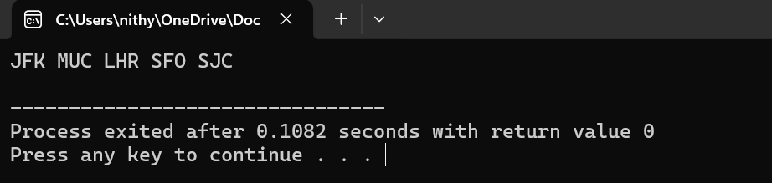
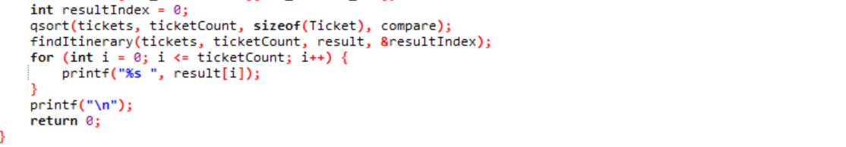
Coding and Screenshot
Output:

Slide 7

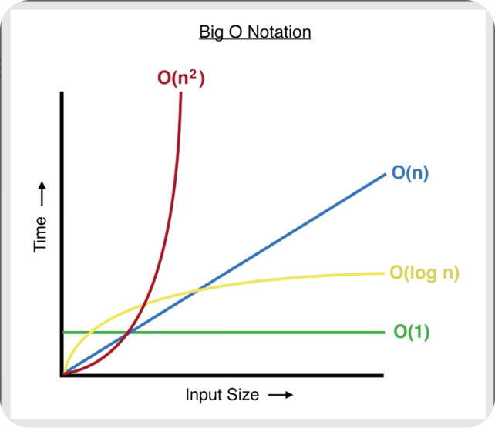


Time and Space Complexity
The time complexity of the Reconstruct Itinerary algorithm is O(V + E), where V is the number of cities and E is the number of flights. This is because the algorithm visits each city and edge at most once during the DFS traversal.
Time Complexity
O(n)
Space Complexity
O(n²)

Slide 8


Edge Cases and Handling
The algorithm needs to handle edge cases such as invalid input, disconnected graphs, and cycles in the graph.
Invalid Input
The algorithm should handle cases where the input data is invalid, such as missing flights or duplicate flights.
Disconnected Graph
If the graph is disconnected, the algorithm should not attempt to reconstruct an itinerary that visits all cities. It should return an empty itinerary.
Cycles
The algorithm should handle cases where the graph contains cycles. If a cycle exists, the algorithm may enter an infinite loop. To prevent this, it can check if a city has been visited twice during the traversal. If a city has been visited twice, the algorithm should backtrack to the previous city.

Slide 9


Practical Applications
This algorithm has practical applications in various fields, including:
1
Airline Route Optimization
Airlines can use this algorithm to optimize flight routes and create efficient itineraries for passengers.
2
Travel Planning
Travel agencies and websites can leverage this algorithm to generate personalized itineraries for travelers based on their preferences and constraints.
3
Delivery Routing
Delivery companies can use this algorithm to optimize delivery routes and ensure efficient delivery of packages.

Slide 10



Conclusion
The Reconstruct Itinerary problem is a classic algorithmic challenge with practical applications in various domains. By understanding the problem, the input data structure, and the DFS approach, we can develop efficient algorithms to solve this problem.

